Slide 1
CS F415: Data Mining
Yashvardhan Sharma

Slide 2
Today’s Outline
Data Preprocessing
  Types of Data Sets
  Why preprocess the data?
  Types of Data
  Data Quality

Slide 3
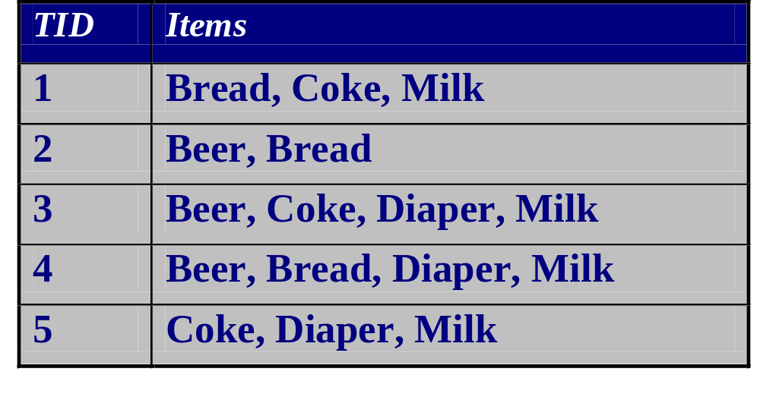
Transaction Data
A special type of record data, where
  each record (transaction) involves a set of items.
  For example, consider a grocery store. The set of products purchased by a customer during one shopping trip constitute a transaction, while the individual products that were purchased are the items.

Slide 4
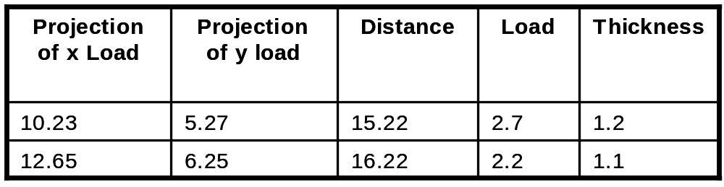
Data Matrix
If data objects have the same fixed set of numeric attributes, then the data objects can be thought of as points in a multi-dimensional space, where each dimension represents a distinct attribute
Such data set can be represented by an m by n matrix, where there are m rows, one for each object, and n columns, one for each attribute

Slide 5
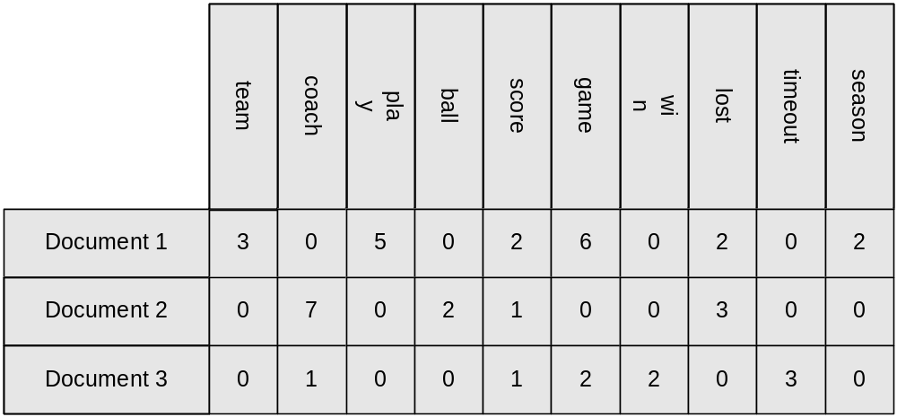
Document – term matrix
Each document becomes a ‘term’ vector,
  each term is a component (attribute) of the vector,
  the value of each component is the number of times the corresponding term occurs in the document.

Slide 6
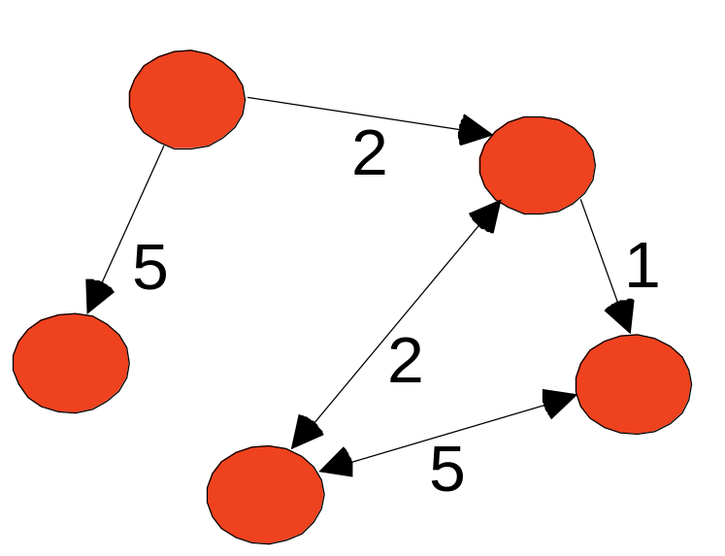
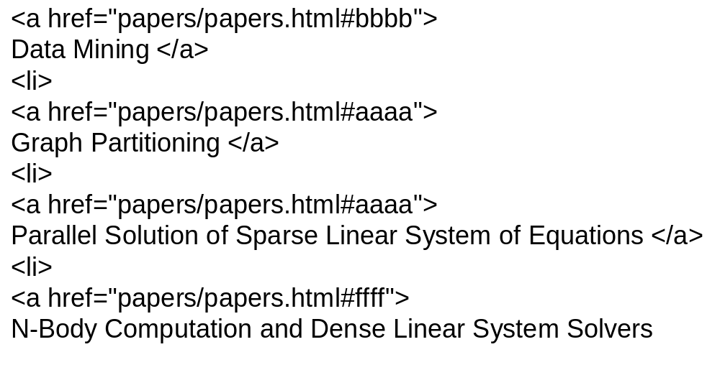
Graph Data
Examples: Generic graph and HTML Links

Slide 7
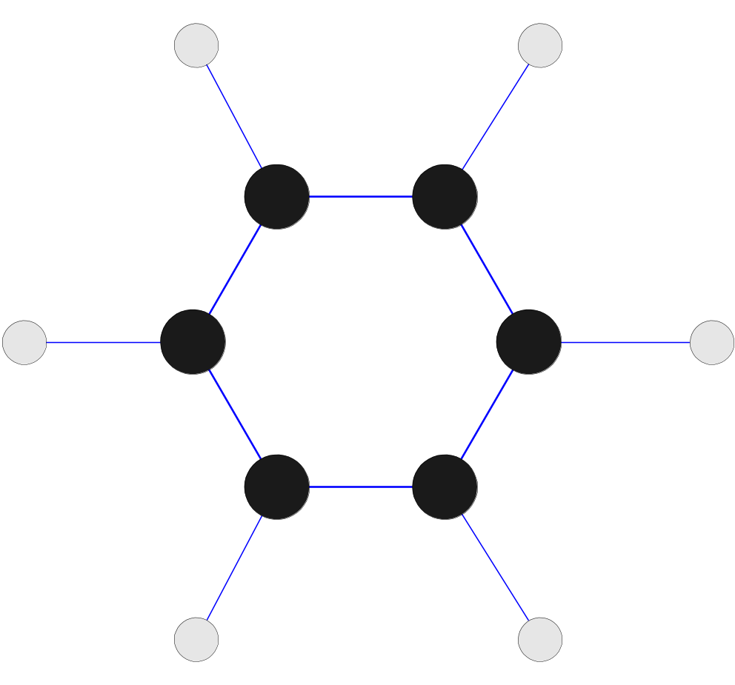
Chemical Data
Benzene Molecule: C₆H₆

Slide 8
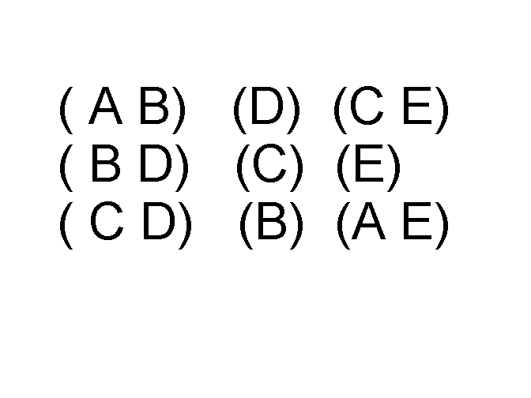
Ordered Data
Sequences of transactions
Items/Events
An element of the sequence

Slide 9
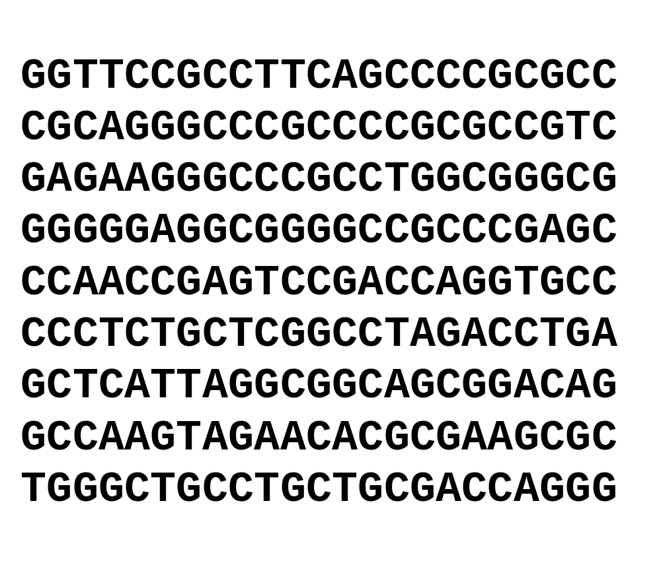
Ordered Data
Genomic sequence data

Slide 10
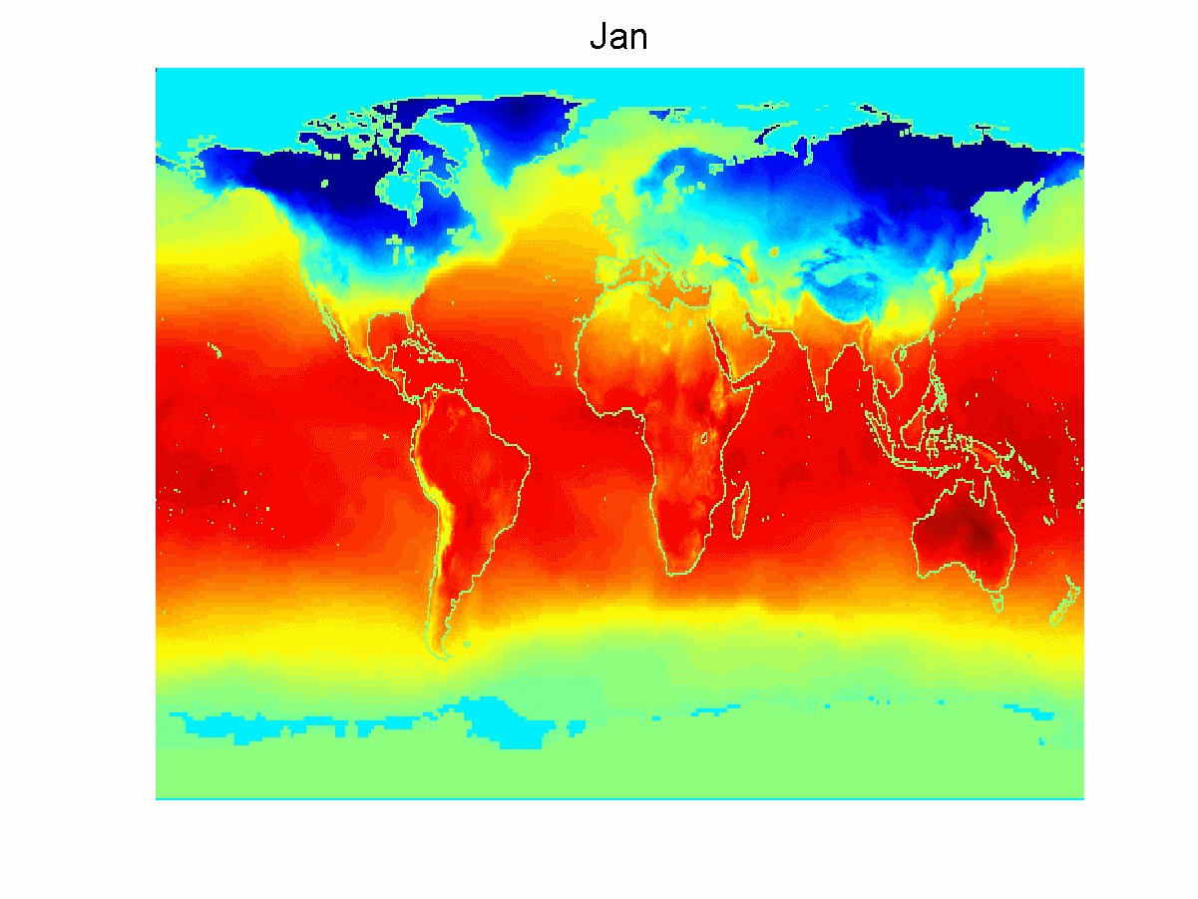
Ordered Data
Spatio-Temporal Data
Average Monthly Temperature of land and ocean

Slide 11
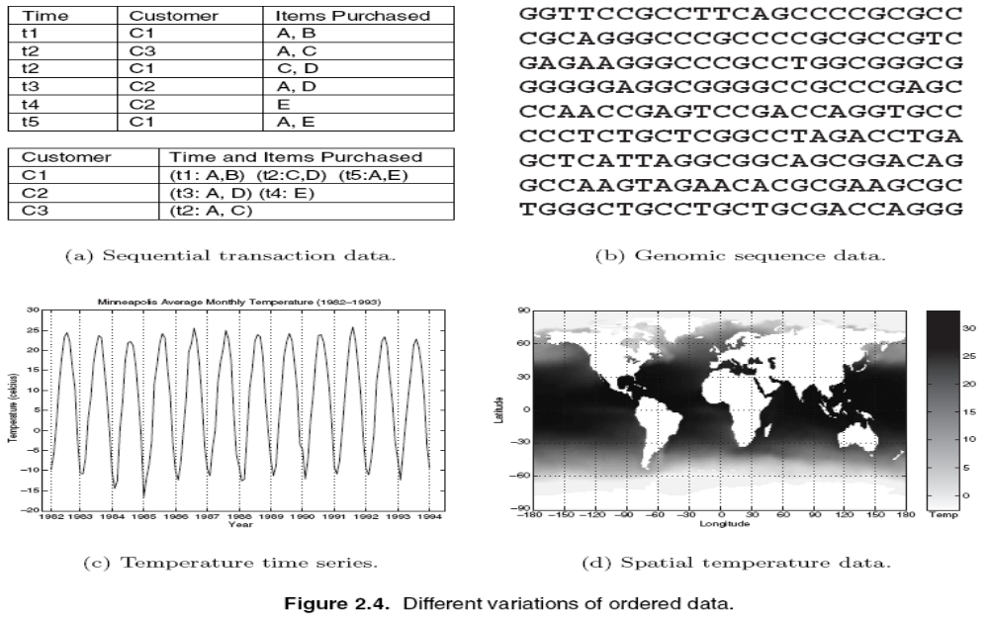

Slide 12
Why Data Preprocessing?
Data in the real world is dirty
  incomplete: lacking attribute values, lacking certain attributes of interest, or containing only aggregate data
  noisy: containing errors or outliers
  inconsistent: containing discrepancies in codes or names
No quality data, no quality mining results!
  Quality decisions must be based on quality data
  Data warehouse needs consistent integration of quality data
  Required for both OLAP and Data Mining!

Slide 13
Why can Data be Incomplete?
Attributes of interest are not available (e.g., customer information for sales transaction data)
Data were not considered important at the time of transactions, so they were not recorded!
Data not recorded because of misunderstanding or malfunctions
Data may have been recorded and later deleted!
Missing/unknown values for some data

Slide 14
Why can Data be Noisy/Inconsistent?
Faulty instruments for data collection
Human or computer errors
Errors in data transmission
Technology limitations (e.g., sensor data come at a faster rate than they can be processed)
Inconsistencies in naming conventions or data codes (e.g., 2/5/2002 could be 2 May 2002 or 5 Feb 2002)
Duplicate tuples, which were received twice should also be removed

Slide 15
Multi-Dimensional Measure of Data Quality
A well-accepted multidimensional view:
  Accuracy
  Completeness
  Consistency
  Timeliness
  Believability
  Value added
  Interpretability
  Accessibility
Broad categories:
  intrinsic, contextual, representational, and accessibility.

Slide 16
Major Tasks in Data Preprocessing
outliers=exceptions!
Data cleaning
  Fill in missing values, smooth noisy data, identify or remove
  outliers, and resolve inconsistencies
Data integration
  Integration of multiple databases, data cubes, or files
Data transformation
  Normalization and aggregation
Data reduction
  Obtains reduced representation in volume but produces the same or similar analytical results
Data discretization
  Part of data reduction but with particular importance, especially for numerical data

Slide 17
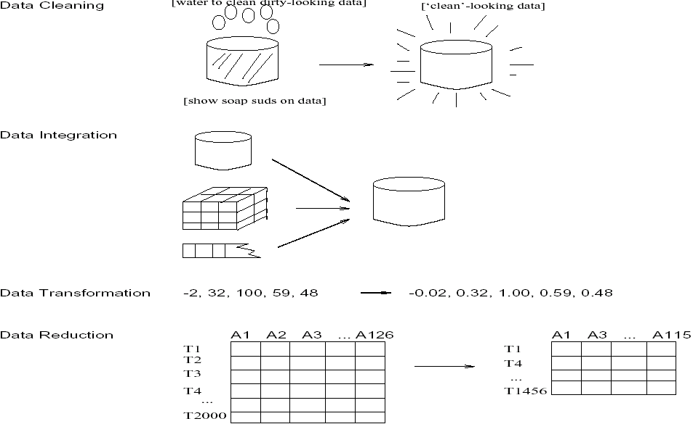
Forms of data preprocessing

Slide 18
Data Quality
What kinds of data quality problems?
How can we detect problems with the data?
What can we do about these problems?
Examples of data quality problems:
  Noise and outliers
  missing values
  duplicate data

Slide 19
Data Cleaning
Importance
  “Data cleaning is one of the three biggest problems in data warehousing”—Ralph Kimball
  “Data cleaning is the number one problem in data warehousing”—DCI survey
Data cleaning tasks
  Fill in missing values
  Identify outliers and smooth out noisy data
  Correct inconsistent data
  Resolve redundancy caused by data integration

Slide 20
Missing Data
Data is not always available
  E.g., many tuples have no recorded value for several attributes, such as customer income in sales data
Missing data may be due to
  equipment malfunction
  inconsistent with other recorded data and thus deleted
  data not entered due to misunderstanding
  certain data may not be considered important at the time of entry
  not register history or changes of the data
Missing data may need to be inferred.

Slide 21
Missing Values
Reasons for missing values
  Information is not collected
  (e.g., people decline to give their age and weight)
  Attributes may not be applicable to all cases
  (e.g., annual income is not applicable to children)
Handling missing values
  Eliminate Data Objects
  Estimate Missing Values
  Ignore the Missing Value During Analysis
  Replace with all possible values (weighted by their probabilities)

Slide 22
How to Handle Missing Data?
Ignore the tuple: usually done when class label is missing (assuming the tasks in classification—not effective when the percentage of missing values per attribute varies considerably.
Fill in the missing value manually: tedious + infeasible?
Fill in it automatically with
  a global constant : e.g., “unknown”, a new class?!
  the attribute mean
  the attribute mean for all samples belonging to the same class: smarter
  the most probable value: inference-based such as Bayesian formula or decision tree

Slide 23
Noisy Data
Noise: random error or variance in a measured variable
Incorrect attribute values may due to
  faulty data collection instruments
  data entry problems
  data transmission problems
  technology limitation
  inconsistency in naming convention
Other data problems which requires data cleaning
  duplicate records
  incomplete data
  inconsistent data

Slide 24
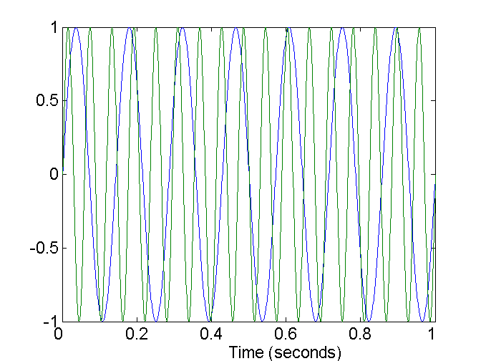
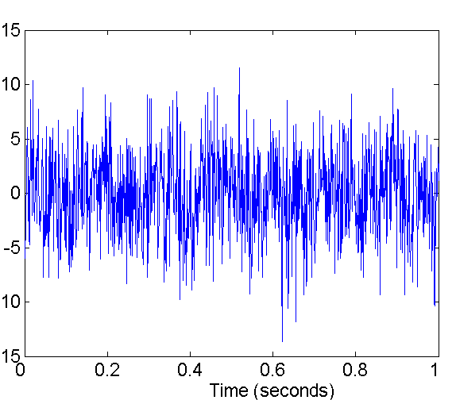
Noise
Noise refers to modification of original values
  Examples: distortion of a person’s voice when talking on a poor phone
Two Sine Waves
Two Sine Waves + Noise

Slide 25
How to Handle Noisy Data?
Binning method:
  first sort data and partition into (equi-depth) bins
  then one can smooth by bin means, smooth by bin median, smooth by bin boundaries, etc.
Clustering
  detect and remove outliers
Combined computer and human inspection
  detect suspicious values and check by human (e.g., deal with possible outliers)
Regression
  smooth by fitting the data into regression functions

Slide 26
Simple Discretization Methods: Binning
Equal-width (distance) partitioning:
  Divides the range into N intervals of equal size: uniform grid
  if A and B are the lowest and highest values of the attribute, the width of intervals will be: W = (B –A)/N.
  The most straightforward, but outliers may dominate presentation
  Skewed data is not handled well.
Equal-depth (frequency) partitioning:
  Divides the range into N intervals, each containing approximately same number of samples
  Good data scaling
  Managing categorical attributes can be tricky.

Slide 27
Binning Methods for Data Smoothing
Sorted data (e.g., by price)
  4, 8, 9, 15, 21, 21, 24, 25, 26, 28, 29, 34
Partition into (equi-depth) bins:
  Bin 1: 4, 8, 9, 15
  Bin 2: 21, 21, 24, 25
  Bin 3: 26, 28, 29, 34
Smoothing by bin means:
  Bin 1: 9, 9, 9, 9
  Bin 2: 23, 23, 23, 23
  Bin 3: 29, 29, 29, 29
Smoothing by bin boundaries:
  Bin 1: 4, 4, 4, 15
  Bin 2: 21, 21, 25, 25
  Bin 3: 26, 26, 26, 34

Slide 28
Cluster Analysis

Slide 29
Regression
y
Y1
Y1’
y = x + 1
X1
x

Slide 30
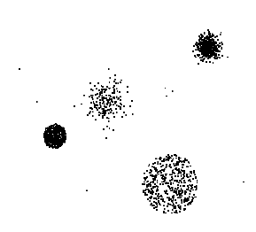
Outliers
Outliers are data objects with characteristics that are considerably different than most of the other data objects in the data set

Slide 31
Duplicate Data
Data set may include data objects that are duplicates, or almost duplicates of one another
  Major issue when merging data from heterogeneous sources
Examples:
  Same person with multiple email addresses
Data cleaning
  Process of dealing with duplicate data issues

Slide 32
Data Preprocessing
Aggregation
Sampling
Dimensionality Reduction
Feature subset selection
Feature creation
Discretization and Binarization
Attribute Transformation

Slide 33
Data Reduction Strategies
A data warehouse may store terabytes of data
  Complex data analysis/mining may take a very long time to run on the complete data set
Data reduction
  Obtain a reduced representation of the data set that is much smaller in volume but yet produce the same (or almost the same) analytical results
Data reduction strategies
  Data cube aggregation
  Dimensionality reduction — remove unimportant attributes
  Data Compression
  Discretization and concept hierarchy generation

Slide 34
Aggregation
Combining two or more attributes (or objects) into a single attribute (or object)
Purpose
  Data reduction
    Reduce the number of attributes or objects
  Change of scale
    Cities aggregated into regions, states, countries, etc
  More “stable” data
    Aggregated data tends to have less variability

Slide 35
Data Cube Aggregation
The lowest level of a data cube
  the aggregated data for an individual entity of interest
  e.g., a customer in a phone calling data warehouse.
Multiple levels of aggregation in data cubes
  Further reduce the size of data to deal with
Reference appropriate levels
  Use the smallest representation which is enough to solve the task
Queries regarding aggregated information should be answered using data cube, when possible

Slide 36
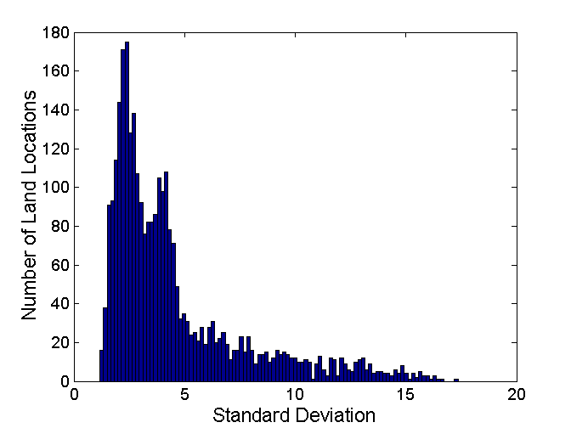
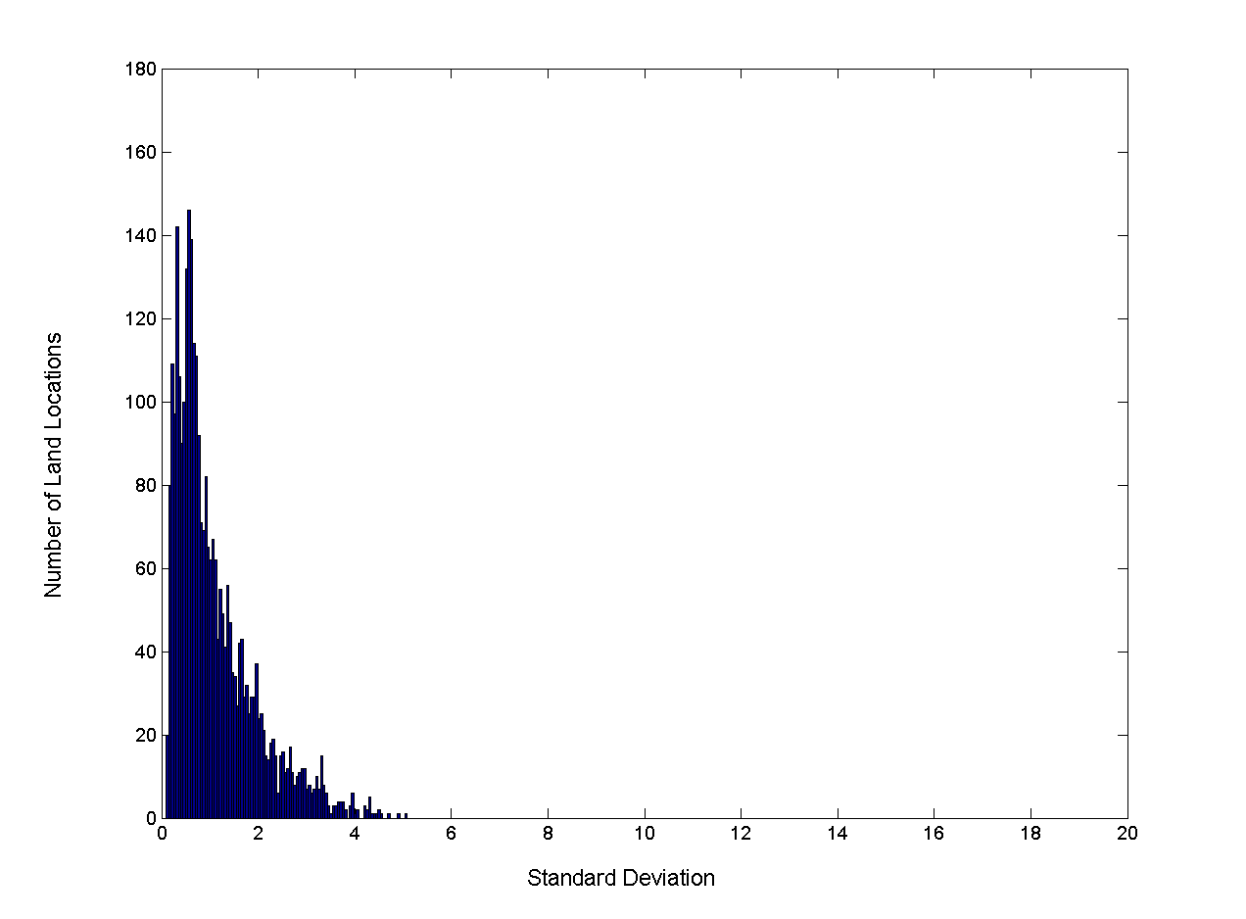
Aggregation
Variation of Precipitation in Australia
Standard Deviation of Average Monthly Precipitation
Standard Deviation of Average Yearly Precipitation

Slide 37
Sampling
Sampling is the main technique employed for data selection.
  It is often used for both the preliminary investigation of the data and the final data analysis.
Statisticians sample because obtaining the entire set of data of interest is too expensive or time consuming.
Sampling is used in data mining because processing the entire set of data of interest is too expensive or time consuming.

Slide 38
Sampling …
The key principle for effective sampling is the following:
  using a sample will work almost as well as using the entire data sets, if the sample is representative
  A sample is representative if it has approximately the same property (of interest) as the original set of data

Slide 39
Types of Sampling
Simple Random Sampling
  There is an equal probability of selecting any particular item
Sampling without replacement
  As each item is selected, it is removed from the population
Sampling with replacement
  Objects are not removed from the population as they are selected for the sample.
    In sampling with replacement, the same object can be picked up more than once
Stratified sampling
  Split the data into several partitions; then draw random samples from each partition

Slide 40
Sampling
Allow a mining algorithm to run in complexity that is potentially sub-linear to the size of the data
Choose a representative subset of the data
  Simple random sampling may have very poor performance in the presence of skew
Develop adaptive sampling methods
  Stratified sampling:
    Approximate the percentage of each class (or subpopulation of interest) in the overall database
    Used in conjunction with skewed data
Sampling may not reduce database I/Os (page at a time).

Slide 41
Sampling
SRSWOR
(simple random
sample without
replacement)
SRSWR
Raw Data

Slide 42
Sampling
Raw Data
Cluster/Stratified Sample

Slide 43

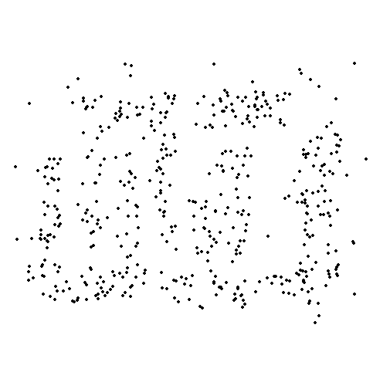
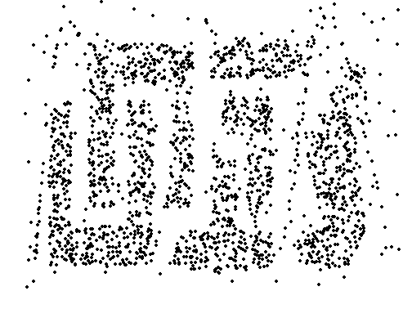
Sample Size
8000 points 2000 Points 500 Points

Slide 44
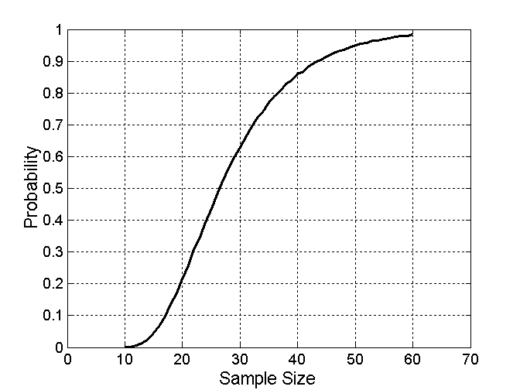

Sample Size
What sample size is necessary to get at least one object from each of 10 groups.

Slide 45
Dimensionality Reduction
Feature selection (i.e., attribute subset selection):
  Select a minimum set of features such that the probability distribution of different classes given the values for those features is as close as possible to the original distribution given the values of all features
  reduce # of patterns in the patterns, easier to understand
Heuristic methods (due to exponential # of choices):
  step-wise forward selection
  step-wise backward elimination
  combining forward selection and backward elimination
  decision-tree induction

Slide 46
Dimensionality Reduction
Purpose:
  Avoid curse of dimensionality
  Reduce amount of time and memory required by data mining algorithms
  Allow data to be more easily visualized
  May help to eliminate irrelevant features or reduce noise
Techniques
  Principle Component Analysis
  Singular Value Decomposition
  Others: supervised and non-linear techniques

Slide 47
Example of
Decision Tree Induction
Initial attribute set:
{A1, A2, A3, A4, A5, A6}
A4 ?
A1?
A6?
Class 1
Class 2
Class 1
Class 2
>
Reduced attribute set: {A1, A4, A6}

Slide 48
Heuristic Feature Selection Methods
There are 2^{d} possible sub-features of d features
Several heuristic feature selection methods:
  Best single features under the feature independence assumption: choose by significance tests.
  Best step-wise feature selection:
    The best single-feature is picked first
    Then next best feature condition to the first, ...
  Step-wise feature elimination:
    Repeatedly eliminate the worst feature
  Best combined feature selection and elimination:
  Optimal branch and bound:
    Use feature elimination and backtracking

Slide 49
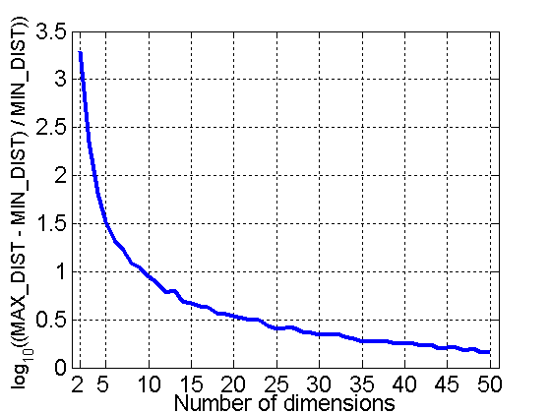
Curse of Dimensionality
When dimensionality increases, data becomes increasingly sparse in the space that it occupies
Definitions of density and distance between points, which is critical for clustering and outlier detection, become less meaningful
Randomly generate 500 points
Compute difference between max and min distance between any pair of points

